Slide 1
Applied Natural Language Processing
Dr. Sucharitha Shetty

Slide 2
Table of Contents
Recall of Last Class
Porter Stemmer
One Hot Encoding
TF-IDF

Slide 3
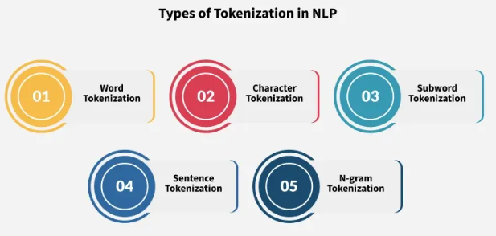
Recall:Types of Tokenization

Slide 4
Stemmers
There are three criteria for evaluating stemmers:
Correctness - Does the stemmer produce accurate root forms?
Efficiency of the task - How fast does it process words? This matters when handling large text volumes.
Compression performance - How well does it consolidate vocabulary? A good stemmer reduces many related words to fewer root forms, making indexes smaller and searches more effective.

Slide 5
Evaluation of Stemmers
There are two ways in which stemming can be incorrect:
● Over-stemming (too much of the term is removed)
○ Two or more words being reduced to the same wrong root
○ e.g., ‘centennial’, ‘century’, ‘center’: ‘cent’
● Under-stemming (too little of the term is removed)
○ Two or more words could be wrongly reduced to more than one root word
○ e.g., ‘acquire’, ‘acquiring’, ‘acquired’: acquir ‘acquisition’: ‘acquis’

Slide 6
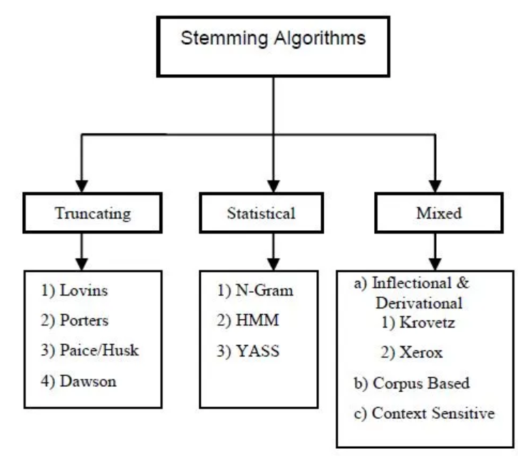
Stemmers

Slide 7
Porter Stemmer (1980)
A multi-step, longest-match stemmer.
M. F. Porter, An algorithm for suffix stripping. (Originally published in Program, 14 no. 3, pp 130-137, July 1980.) Notation
v vowel(s)
c constant(s)
(vc)m vowel(s) followed by constant(s), repeated m times
Any word can be written: [c](vc)m[v]
m is called the measure of the word

Slide 8
Porter Stemmer
Porter Stemming Algorithm
Complex suffixes are removed bit by bit in the different steps. Thus:
GENERALIZATIONS
becomes GENERALIZATION (Step 1)
becomes GENERALIZE (Step 2)
becomes GENERAL (Step 3)
becomes GENER (Step 4).

Slide 9
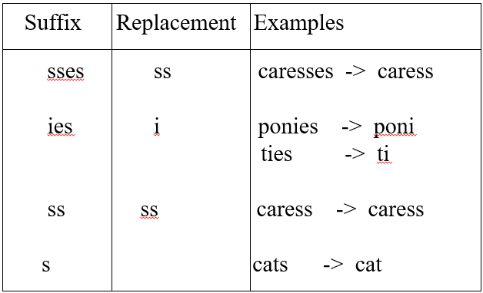
Porter Stemmer

Slide 10
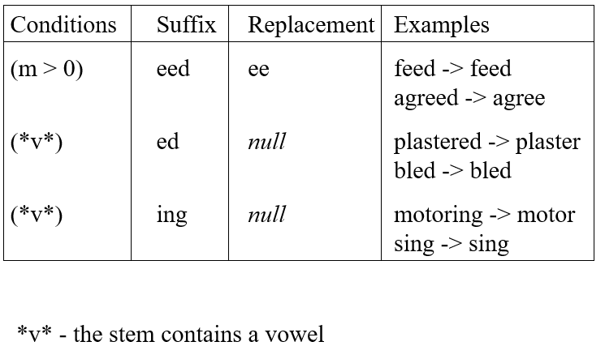
Porter Stemmer

Slide 11
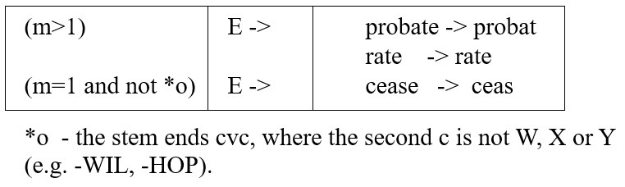
Porter Stemmer

Slide 12
Krovetz Stemmer (1993)
The Krovetz Stemmer is a conservative, dictionary-based stemming algorithm designed to minimize stemming errors, particularly over-stemming. It was developed by Robert Krovetz in 1993 and takes a more cautious approach compared to aggressive stemmers like Porter.
Key Characteristics
Dictionary-driven approach: Unlike purely rule-based stemmers, Krovetz uses a dictionary to verify that stemmed forms are actual valid words. It only stems a word if the resulting stem exists in its lexicon.
Conservative philosophy: The stemmer follows the principle "when in doubt, don't stem." This reduces over-stemming errors at the cost of slightly higher under-stemming.

Slide 13
Krovetz Stemmer (1993)
Light stemming: It performs minimal transformations, primarily handling:
Plural removal (cats → cat)
Past tense (walked → walk)
Progressive forms (running → run)
Comparative forms (bigger → big)

Slide 14
Krovetz Stemmer (1993)
How It Works
The Krovetz algorithm follows this general process:
Check if the word exists in the dictionary - If yes, return it as-is
Remove plural suffixes - Try removing 's' or 'es' and check if the result is in the dictionary
Remove past tense - Try removing 'ed' and check validity
Remove '-ing' forms - With appropriate spelling adjustments
Verify each step - Only accept the stem if it's a legitimate dictionary word

Slide 15
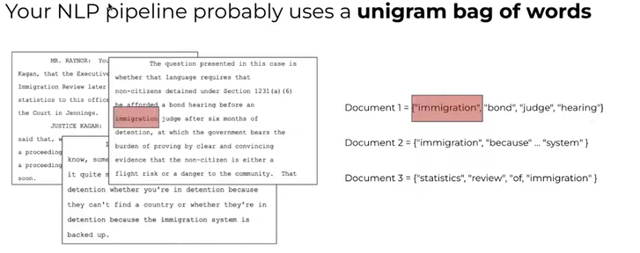
N-grams

Slide 16
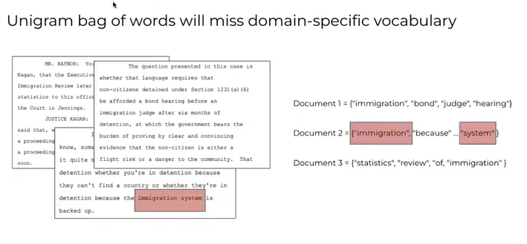

Slide 17
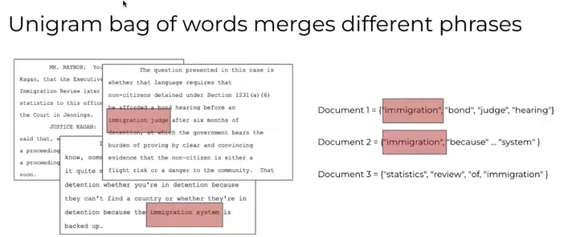

Slide 18
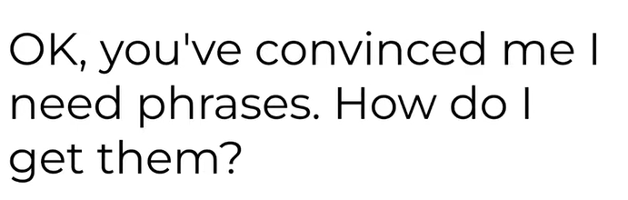
Krovetz Stemmer (1993)

Slide 19
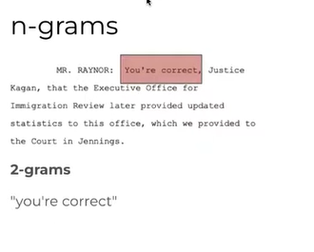
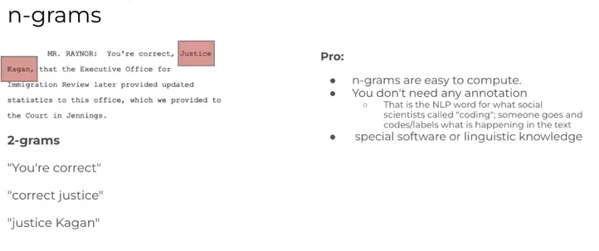
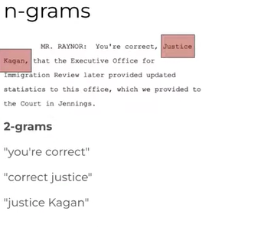

Slide 20
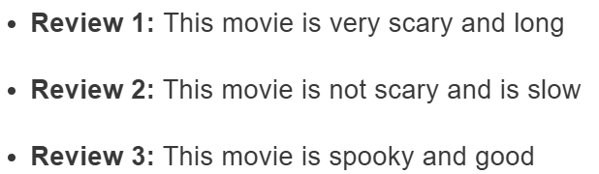
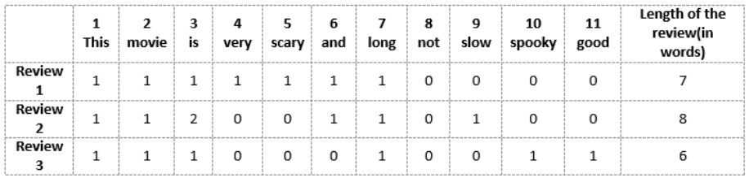
Vector-of-Review1: [1 1 1 1 1 1 1 0 0 0 0]
Vector-of-Review2: [1 1 2 0 0 1 1 0 1 0 0]
Vector-of-Review3: [1 1 1 0 0 0 1 0 0 1 1]
Bag of Words
We can now take each of these words and mark their occurrence in the three movie reviews above with 1s and 0s. This will give us 3 vectors for 3 reviews:
Vector-of-Review1: [1 1 1 1 1 1 1 0 0 0 0]
Vector-of-Review2: [1 1 2 0 0 1 1 0 1 0 0]
Vector-of-Review3: [1 1 1 0 0 0 1 0 0 1 1]

Slide 21
Drawbacks of using a Bag-of-Words (BoW) Model
If the new sentences contain new words, then our vocabulary size would increase and thereby, the length of the vectors would increase too.
Additionally, the vectors would also contain many 0s, thereby resulting in a sparse matrix (which is what we would like to avoid)
We are retaining no information on the grammar of the sentences nor on the ordering of the words in the text.

Slide 22
TF-IDF
Term frequency–inverse document frequency, is a numerical statistic that is intended to reflect how important a word is to a document in a collection or corpus.

Slide 23

Term Frequency (TF)
Let’s first understand Term Frequent (TF). It is a measure of how frequently a term, t, appears in a document, d:
Here, in the numerator, n is the number of times the term “t” appears in the document “d”. Thus, each document and term would have its own TF value.

Slide 24
Term Frequency (TF)
Review 2: This movie is not scary and is slow
Vocabulary: ‘This’, ‘movie’, ‘is’, ‘very’, ‘scary’, ‘and’, ‘long’, ‘not’, ‘slow’, ‘spooky’, ‘good’
Number of words in Review 2 = 8
TF for the word ‘this’ = (number of times ‘this’ appears in review 2)/(number of terms in review 2) = 1/8
Similarly,
TF(‘movie’) = 1/8 TF(‘is’) = 2/8 = ¼ TF(‘very’) = 0/8 = 0 TF(‘scary’) = 1/8
TF(‘and’) = 1/8 TF(‘long’) = 0/8 = 0 TF(‘not’) = 1/8 TF(‘slow’) = 1/8
TF( ‘spooky’) = 0/8 = 0 TF(‘good’) = 0/8 = 0

Slide 25
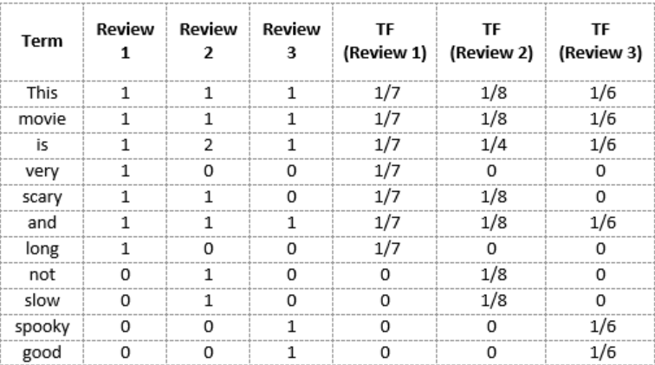
Term Frequency (TF)

Slide 26
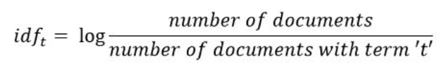
Inverse Document Frequency (IDF)
IDF is a measure of how important a term is. We need the IDF value because computing just the TF alone is not sufficient to understand the importance of words:

Slide 27
IDF
Review 2: This movie is not scary and is slow
IDF(‘this’) = log(number of documents/number of documents containing the word ‘this’) = log(3/3) = log(1) = 0
Similarly,
IDF(‘movie’, ) = log(3/3) = 0 IDF(‘is’) = log(3/3) = 0
IDF(‘not’) = log(3/1) = log(3) = 0.48 IDF(‘scary’) = log(3/2) = 0.18
IDF(‘and’) = log(3/3) = 0 IDF(‘slow’) = log(3/1) = 0.48

Slide 28
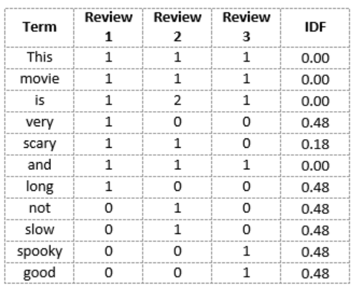
IDF
We see that words like “is”, “this”, “and”, etc., are reduced to 0 and have little importance; while words like “scary”, “long”, “good”, etc. are words with more importance and thus have a higher value.

Slide 29

TF-IDF Score
Words with a higher score are more important, and those with a lower score are less important:
We can now calculate the TF-IDF score for every word in Review 2:
TF-IDF(‘this’, Review 2) = TF(‘this’, Review 2) * IDF(‘this’) = 1/8 * 0 = 0
Similarly,
TF-IDF(‘movie’, Review 2) = 1/8 * 0 = 0 TF-IDF(‘is’, Review 2) = 1/4 * 0 = 0
TF-IDF(‘not’, Review 2) = 1/8 * 0.48 = 0.06 TF-IDF(‘scary’, Review 2) = 1/8 * 0.18 = 0.023
TF-IDF(‘and’, Review 2) = 1/8 * 0 = 0 TF-IDF(‘slow’, Review 2) = 1/8 * 0.48 = 0.06

Slide 30
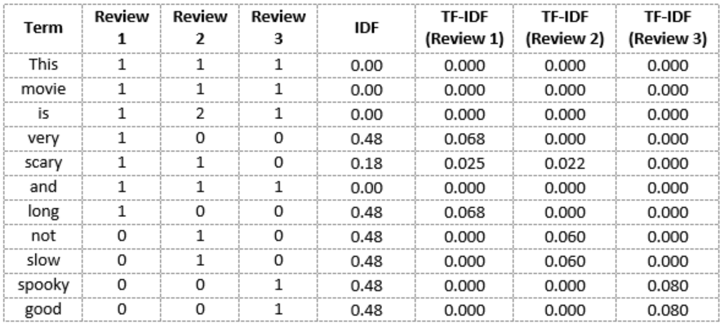
TF-IDF Score

Slide 31
TF-IDF Score
While both Bag-of-Words and TF-IDF have been popular in their own regard, there still remained a void where understanding the context of words was concerned. Detecting the similarity between the words ‘spooky’ and ‘scary’, or translating our given documents into another language, requires a lot more information on the documents.

Slide 32
TF-IDF Score
While both Bag-of-Words and TF-IDF have been popular in their own regard, there still remained a void where understanding the context of words was concerned. Detecting the similarity between the words ‘spooky’ and ‘scary’, or translating our given documents into another language, requires a lot more information on the documents.

Slide 33
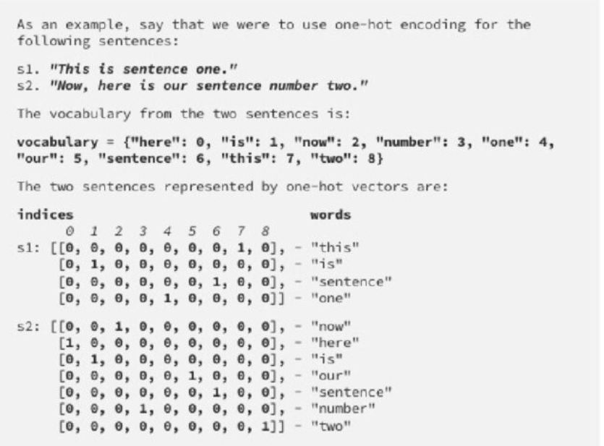
One-Hot
Encoding

Slide 34
A similarity measure is a function that computes the degree of similarity between two vectors.
A good distance metric helps in improving the performance of Classification, Clustering, and Information Retrieval process significantly.
Euclidean Distance
Manhattan Distance
Cosine Similarity
Similarity Measure

Slide 35



Named after the ancient Greek Mathematician Euclid
Euclidean Distance
While both Bag-of-Words and TF-IDF have been popular in their own regard, there still remained a void where understanding the context of words was concerned. Detecting the similarity between the words ‘spooky’ and ‘scary’, or translating our given documents into another language, requires a lot more information on the documents.

Slide 36
Word embedding in natural language processing (NLP) refers to the technique of representing words as dense vectors of real numbers in a high-dimensional space.
This method captures semantic and syntactic similarities between words, allowing NLP models to understand the context and meaning of words within a given text.
Word embeddings are typically learned from large corpora of text using unsupervised learning techniques like neural networks, where words with similar meanings are mapped to nearby points in the embedding space.
Popular word embedding techniques include Bow,TF-IDF, Word2Vec, GloVe.
Word Embedding

Slide 37
Word embedding :
Count/Frequency (BoW, TFIDF, One Hot Encoding)
Deep Learning Trained model (Word2Vec(CBOW,SkipGrams), AvgWord2Vec)
Pre-requisite: ANN, Optimizers and Loss Function
Embedding Layer is used to convert word to vectors
Word Embedding

Slide 38
Coding Time

Slide 39
Thank You

